Slide 1

Interactive Design Fundamentals
PsiFi Project

Slide 2

Student’s Corner

Slide 3
Content
Proposal of the project application area
Researching the "State-of-the-art"
Opportunities for innovation
User's profile
Concept design of the interactive system:
Interaction Design

Slide 4

Proposal of the project Application area
VIDEOS
LINKS
Our web page will display the content of every course that ISC students take to get their degree.
Why did we chose to do it?
User group: Students from the ISC Career (ITESM QRO )
Project impact:
It will be an academic tool
It will help students understand topics learnt in classes
It can be used as review guide
It will provide extra resources to go deeper into any topic that they want/need to know more about.
DISCUSSION BOARD

Slide 5
Researching State-of-the-Art

Slide 6

Stack Overflow
It is a web page which works as a discussion board. Here, users ask questions about specific issues in their own codes. A disadvantage with this webpage is that the answers won’t help with more general doubts or theoretical ones, but more regarding logical errors inside an specific problem. Also the answers might not be completely reliable since anyone can give their own opinion and most of them will give the solution instead of a clear explanation. https://stackoverflow.com/

Slide 7

Plan de Estudios (ITESM)
This is the official webpage created by the Instituto Tecnológico y de Estudios Superiores de Monterrey(ITESM). The page provides information regarding the courses seen in the career of ISC. The courses can be organised by category or period(semester). When clicking the course key, specific information such as credits, equivalences and suggested bibliography are displayed.
http://serviciosva.itesm.mx/PlanesEstudio/Consultas/Planes/ConsultaPlanEstudio.aspx?form=PLANESTUDIO&contenido=caratula&modovista=periodo&Idioma=ESP&claveprograma=ISC11&UnaCol=&VerReq=&VerEqui=

Slide 8
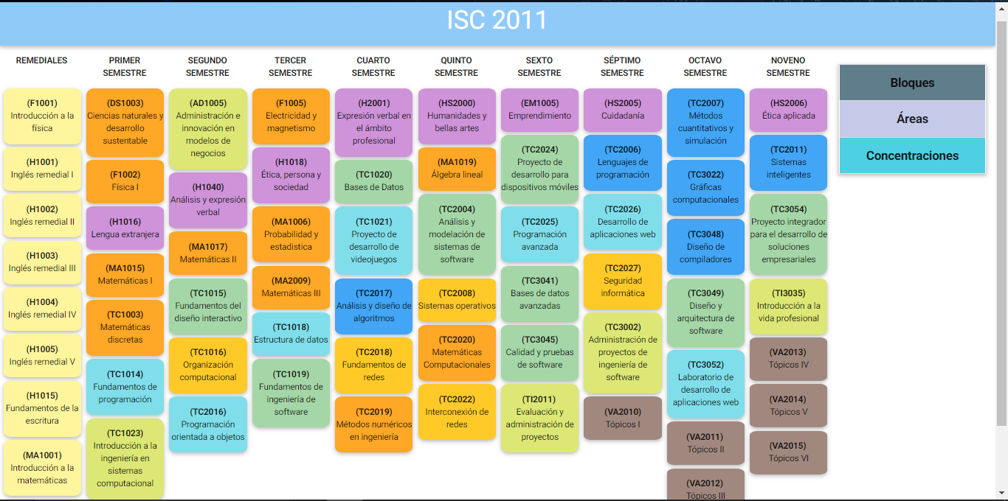
Plan de Estudios
(Student made)
It displays what the Plan de Estudios Profesional does but in an easier and more interactive presentation. Lacks some important information such as suggested bibliography and its main focus differs from ours.
http://tamayo.qro.itesm.mx/ricardo/planDeEstudios/planDeEstudioISC2011.html

Slide 9

Khan Academy
This webpage has more specific information about many different topics and is divided by subjects. One of the things that makes it stand out is the use of videos with examples for explanations and also its simplicity and self-paced style. What we are trying to pursue is also this kind of auto learning but including the categories divided by specific needs of our users.
https://es.khanacademy.org/

Slide 10

Coursera
The courses provided by coursera are also based on videos. They are created by professionals who concentrate on certain topic and usually include suggested bibliography and exercises which are optional.
More practical than theoretical.
Our objective is making our web page easy and interactive as Coursera, but also adding some theoretical information because it is also relevant for university students. https://www.coursera.org/

Slide 11

edX
Offers high quality courses from the world's best universities and institutions to learners everywhere. You can get a certification if you pay the fee, or you can learn for free if you do not want/need the certification. It is similar to what we are trying to do with our page, however, edX focuses more on giving the full course experience, with homeworks and assignments you need to do, and our page is more oriented towards offering students (particularly the ones at ITESM) additional information about the topics and providing them useful links. https://www.edx.org/

Slide 12

Blackboard
Focused on full courses rather than individual subjects.
Design is by categories and it gives the option of creating more folders for your personal needs (like homework or team projects).
It adds multiple functionalities. However, it has more tools than what our users need. Also, teachers would find it easier to share information or useful links to our page, and they don’t need to do it constantly, once it is uploaded they can let the students find that information and use it to improve their learning process.
https://miscursos.tec.mx

Slide 13
Opportunities for innovation
Blackboard: Teacher to student.
Student’s Corner: From anybody to everybody.
You should be an enrolled student at Tec de Monterrey to have access to the content of the courses that are given in the campus, and we haven’t come across any page that does anything similar.
If we got official support from the teachers we could make this a hub for students to get legitimate and reliable information. One of the things we’ve heard teachers complain about is that when students try to search for information themselves they often find things that either aren’t accurate or they get confused because the teacher explained it differently, with this web page we could help mitigate those problems by giving them the information from a web site previously selected by the teacher.
Our web page could be a nice alternative to blackboard, or it could have some integration with it, maybe a link inside Blackboard that sends you to our page.

Slide 14

User's profile:
Occupation: Student
Name: Johanatan Smith
General characteristics:
Young
Responsible
Persistent
Hard worker
School: ITESM
Age: 21 years
From: Michigan, USA
Major: ISC
Required skills:
Know how to access the internet
Has good communication skills to properly describe a problem

Slide 15

Concept design of the interactive system:
Name of the interactive system.
Student’s Corner
Colour palette, textures, fonts and alignment type.
Red, blue, grey, sans-serif, Align left , centered
Location / geographic extension
Mexico, Queretaro
ITESM (University)
English/Spanish
We’ll use:
HTML, CSS, JavaScript

Slide 16

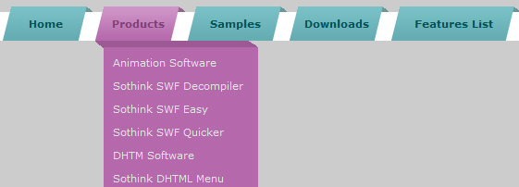
INTERACTION DESIGN
There will be a menu with different sections, which include :
First divided by area, then:
Assignments, Resources and the student’s blog discussion, where they will be allowed to discuss different type of topics or homeworks
The student will click on any course he is interested at, and he can write inside discussion section.
Menu with sections sample

Slide 17
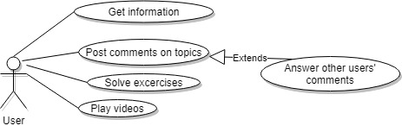
Use Cases

